Slide 1


Variables

Slide 2
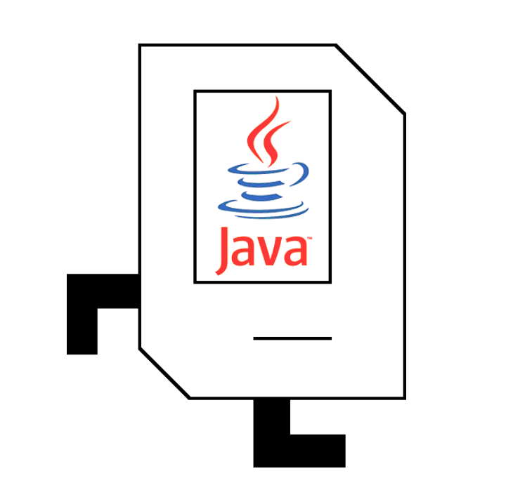
Review

Slide 3
Control Statements
private void methode() {
turnLeft();
}
for(int i = 0; i < N; i++) {
// pour repeater N fois
}
while(condition) {
// toute le code ici repete
// tandis que la condition est vrai
}
if(condition) {
// faire ceci si la condition est vrai
} else {
// faire cela si la condition est faux
}
Notes:
Ask them what they think the difference is between the two types of loops

Slide 4
If-else statements
if(frontIsClear()) {
move();
}
putBeeper();
// true
move();
// false
putBeeper();
if(frontIsClear()) {
move();
} else {
turnLeft();
}
putBeeper();
// true
// false
move();
turnLeft();
putBeeper();

Slide 5
Brackets and Indentation
public void run() {
while (beepersInBag()) {
findTree();
addLeavesToTree();
}
moveToWall();
}
private void addLeavesToTree() {
turnLeft();
climbTree();
addLeaves();
descendToGround();
turnLeft();
private void findTree() {
moveToWall();
}

Slide 6
Brackets and Indentation
public void run() {
while (beepersInBag()) {
findTree();
addLeavesToTree();
}
moveToWall();
}
private void addLeavesToTree() {
turnLeft();
climbTree();
addLeaves();
descendToGround();
turnLeft();
private void findTree() {
moveToWall();
}

Slide 7
Brackets and Indentation
public void run() {
while (beepersInBag()) {
findTree();
addLeavesToTree();
}
moveToWall();
}
private void addLeavesToTree() {
turnLeft();
climbTree();
addLeaves();
descendToGround();
turnLeft();
}
private void findTree() {
moveToWall();
}

Slide 8
Brackets and Indentation
public void run() {
while (beepersInBag()) {
findTree();
addLeavesToTree();
}
moveToWall();
}
private void addLeavesToTree() {
turnLeft();
climbTree();
addLeaves();
descendToGround();
turnLeft();
}
private void findTree() {
moveToWall();
}

Slide 9
Brackets and Indentation
public void run() {
while (beepersInBag()) {
findTree();
addLeavesToTree();
}
moveToWall();
}
private void addLeavesToTree() {
turnLeft();
climbTree();
addLeaves();
descendToGround();
turnLeft();
}
private void findTree() {
moveToWall();
}

Slide 10
Brackets and Indentation
public void run() {
while (beepersInBag()) {
findTree();
addLeavesToTree();
}
moveToWall();
}
private void addLeavesToTree() {
turnLeft();
climbTree();
addLeaves();
descendToGround();
turnLeft();
}
private void findTree() {
moveToWall();
}

Slide 11
Brackets and Indentation
public void run() {
while (beepersInBag()) {
findTree();
addLeavesToTree();
}
moveToWall();
}
private void addLeavesToTree() {
turnLeft();
climbTree();
addLeaves();
descendToGround();
turnLeft();
}
private void findTree() {
moveToWall();
}

Slide 12
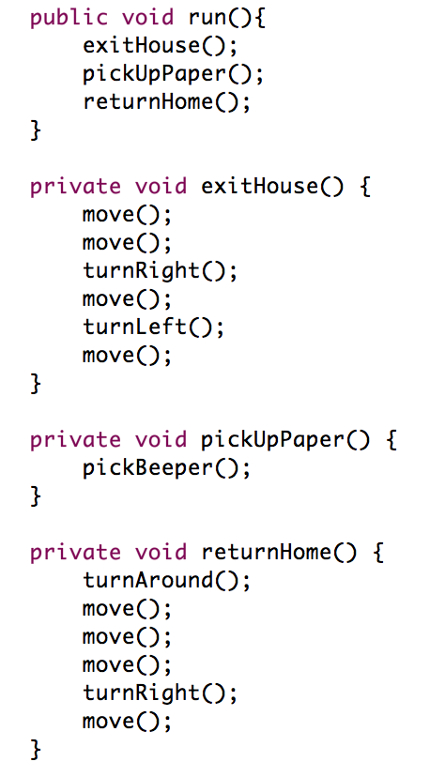
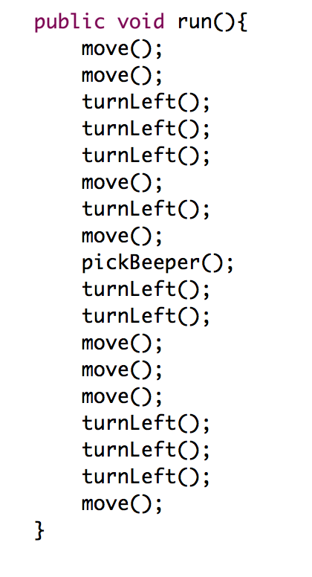
Decomposition - CollectNewspaper
Good
Bad
Use methods to decompose your code.
Notes:
Sey → ”shay”

Slide 13
Good or Bad?
Good
Bad
// moves karel one step
private void git() {
move();
}
// rotates karel
private void solaDon() {
turnLeft();
}
private void sey1() {
move();
}
private void sey2() {
turnLeft();
}
private void sey3() {
putBeeper();
}
Use meaningful names for your methods.

Slide 14
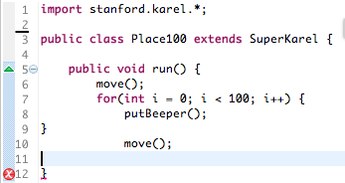
Match your curly braces

Slide 15
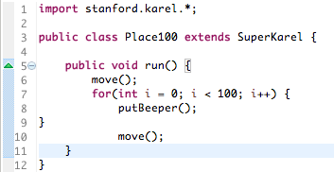

Coding Style
??
??
??

Slide 16
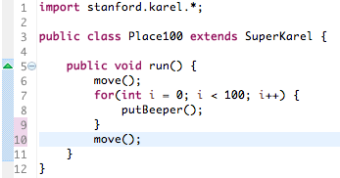

Coding Style

Slide 17
Humans Read Code, Too
Decompose by writing meaningful methods
Indent and match your curly braces

Slide 18
Programming takes practice.

Slide 19
See You Later!
I will miss you.
Enjoy Java!
Call me maybe?

Slide 20

Java

Slide 21


Today’s Goals
How do I write a console program?
What are variables and how do I use them?
How do I get user input in a console program?

Slide 22
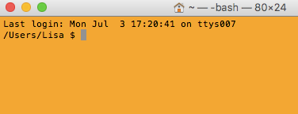
Console Program
Takes text input
Prints text output

Slide 23

First Console Program: Hello World
import acm.program.*;
public class HelloProgram extends ConsoleProgram {
public void run() {
println("hello, world");
}
}
HelloConsole
hello, world

Slide 24


In Pop Culture

Slide 25
Today’s Goals
✓
How do I write a console program?
What are variables and how do I use them?
How do I get user input in a console program?

Slide 26
What is a variable?

Slide 27
[suspense]

Slide 28
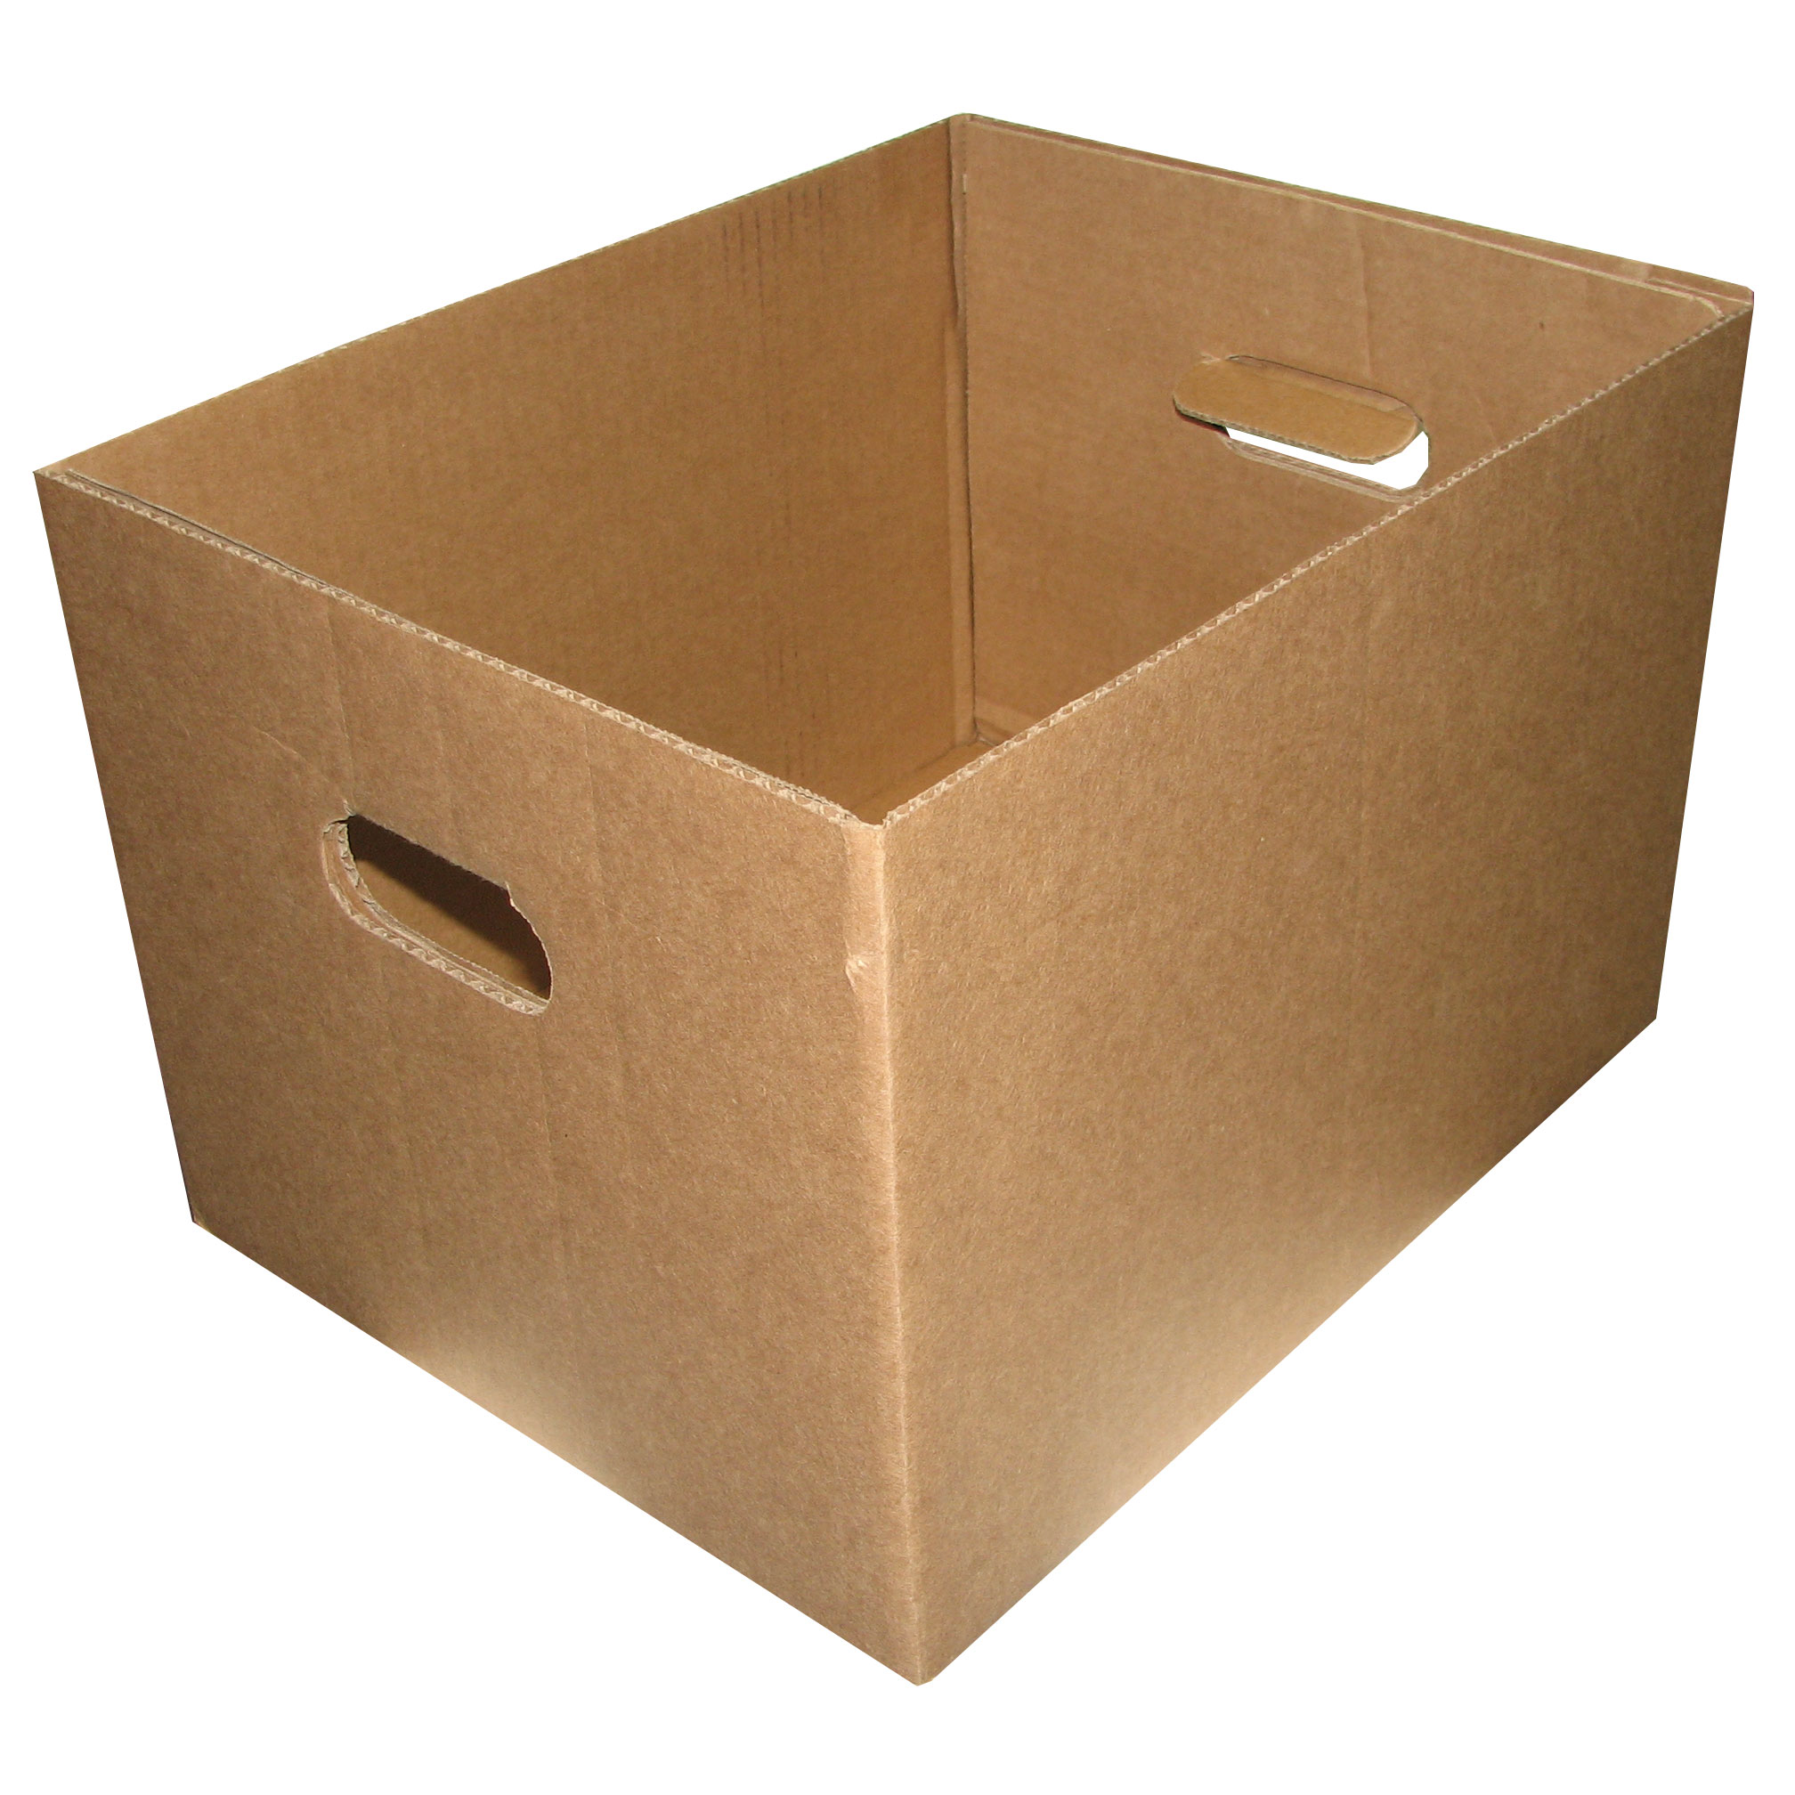
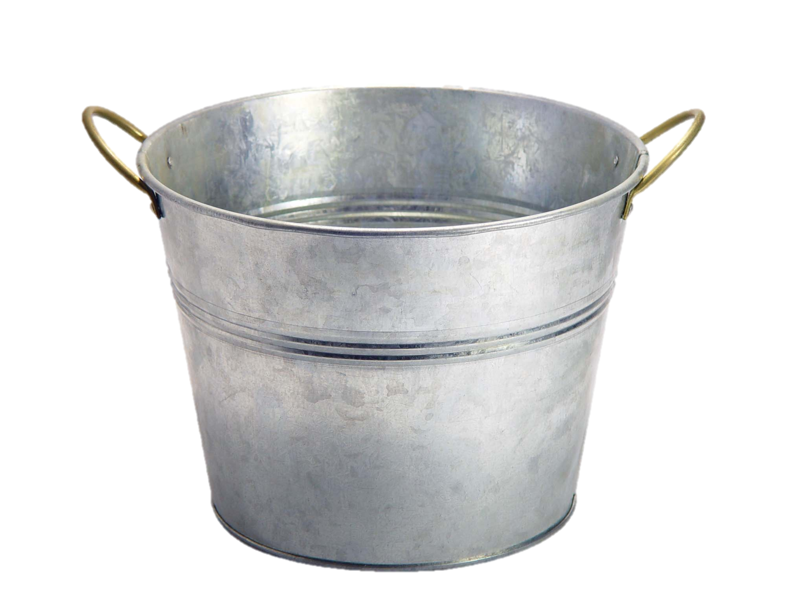
Variables are Like Boxes

Slide 29
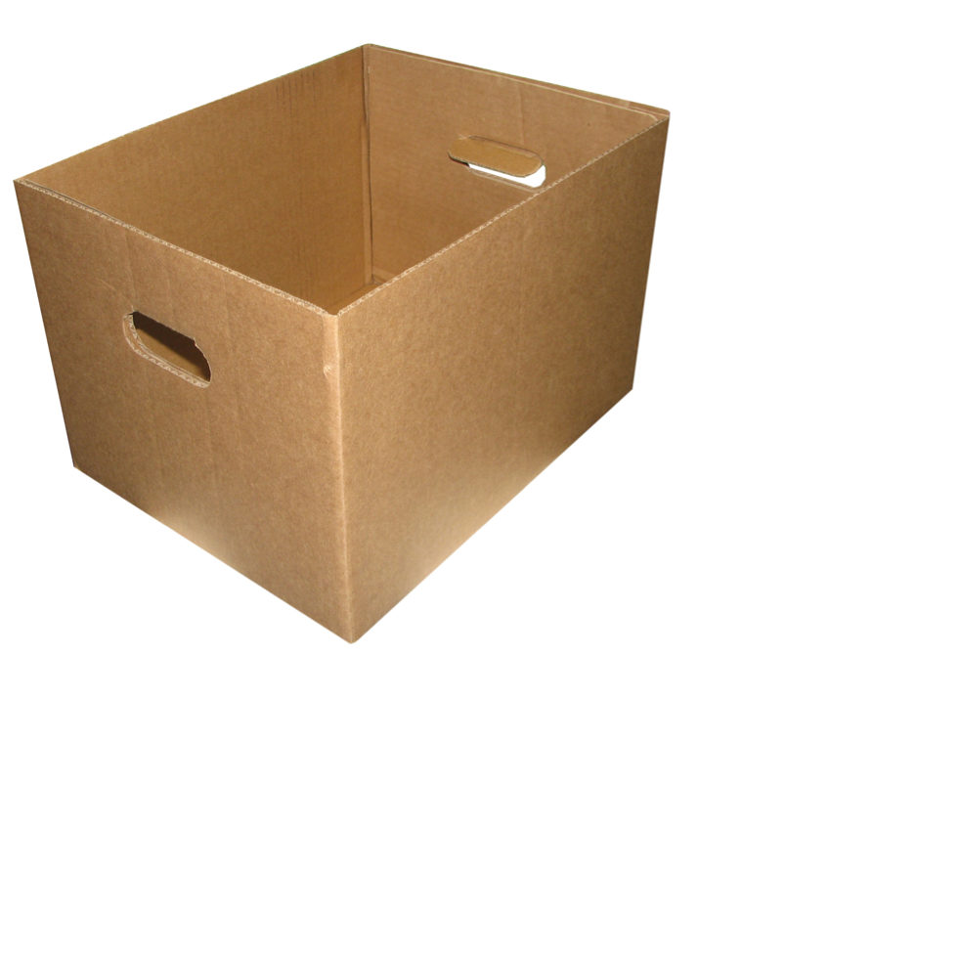
Teeny Tiny Boxes
My computer has space for about 64 billion boxes

Slide 30
Variables are Like Boxes
int total = 42;
name
type
total
42
(contains an int)
value
Notes:
Type name = value

Slide 31
Types
// integer values
int num = 5;
// real values
double fraction = 0.2;
// letters
char letter = ‘c’;
// true or false
boolean isLove = true;

Slide 32

Double: How Much Do I Weigh?
* Answers could be real valued numbers

Slide 33
Int: How Many Children Do I Have?
* It is weird to say something like 1.7

Slide 34
Binary Operators
+
Addition
*
Multiplication
–
Subtraction
/
Division
%
Remainder

Slide 35
Binary Operators
double width = 2.5; // meters
double height = 3.0;
double area = width * height;
name
width
height
area
value
2.5
3.0
7.5
type
double
double
double

Slide 36
Today’s Goals
✓
How do I write a console program?
What are variables and how do I use them?
How do I get user input in a console program?
✓

Slide 37
User Input
int a = readInt(“Give me an int!”);
double b = readDouble(“And a double”);

Slide 38
Add2Integers
public class Add2Integers extends ConsoleProgram {
public void run() {
println("This program adds two numbers.");
int n1 = readInt("Enter n1: ");
int n2 = readInt("Enter n2: ");
int total = n1 + n2;
println("The total is " + total + ".");
}
}
n1
n1
n2
n2
total
total
17
17
25
25
42
42
Add2Integers
This program adds two numbers.
Enter n1:
17
Enter n2:
25
The total is 42.

Slide 39
Birthday
public class Birthday extends ConsoleProgram {
public void run() {
println("This program celebrates birthdays.");
int age = readInt("Enter your age: ");
age = age + 1;
println("Happy birthday!");
println("You are now " + age + ".");
}
}
age
25
26
Add2Integers
This program celebrates birthdays.
Enter your age:
25
Happy birthday!
You are now 26.

Slide 40
Birthday
int age = readInt("Enter your age: ");
age = age + 1;

Slide 41
Birthday
int age = readInt("Enter your age: ");
value
name
age
type
25
(contains an int)

Slide 42
Birthday
int age = readInt("Enter your age: ");
age = age + 1;
value
age
25
(contains an int)

Slide 43
Birthday
int age = readInt("Enter your age: ");
age = age + 1;
25 + 1 = 26
age
25
(contains an int)

Slide 44
Birthday
int age = readInt("Enter your age: ");
age = age + 1;
26
age
25
(contains an int)

Slide 45
Birthday
int age = readInt("Enter your age: ");
age = age + 1;
26
age
26
(contains an int)

Slide 46
What do you think this does?
println(1 / 2);

Slide 47
AHHHHHHH!!!!!!
println(1 / 2);

Slide 48
Resulting Type
int + int results in an int
double + double results in a double
int + double results in a double
* The general rule is: operations always return the most expressive type

Slide 49

Pitfalls of Integer Division
Convert 100˚ Celsius temperature to its Fahrenheit equivalent:
double c = 100;
double f = 9 / 5 * c + 32;
The computation consists of evaluating the following expression:
9 / 5 * c + 32
The problem arises from the fact that both 9 and 5 are of type int, which means that the result is also an int.
132
100
1
9 / 5 * c + 32

Slide 50
Pitfalls of Integer Division
You can fix this problem by converting the fraction to a double, either by inserting decimal points or by using a type cast:
double c = 100;
double f = 9.0 / 5 * c + 32;
The computation now looks like this:
212.0
180.0
1.8
9.0
/ 5 * c + 32

Slide 51
Conditions

Slide 52
Conditions
<
Less Than
==
Equal To
>
Greater Than
>=
More or Equal
<=
Less or Equal

Slide 53
Demo

Slide 54
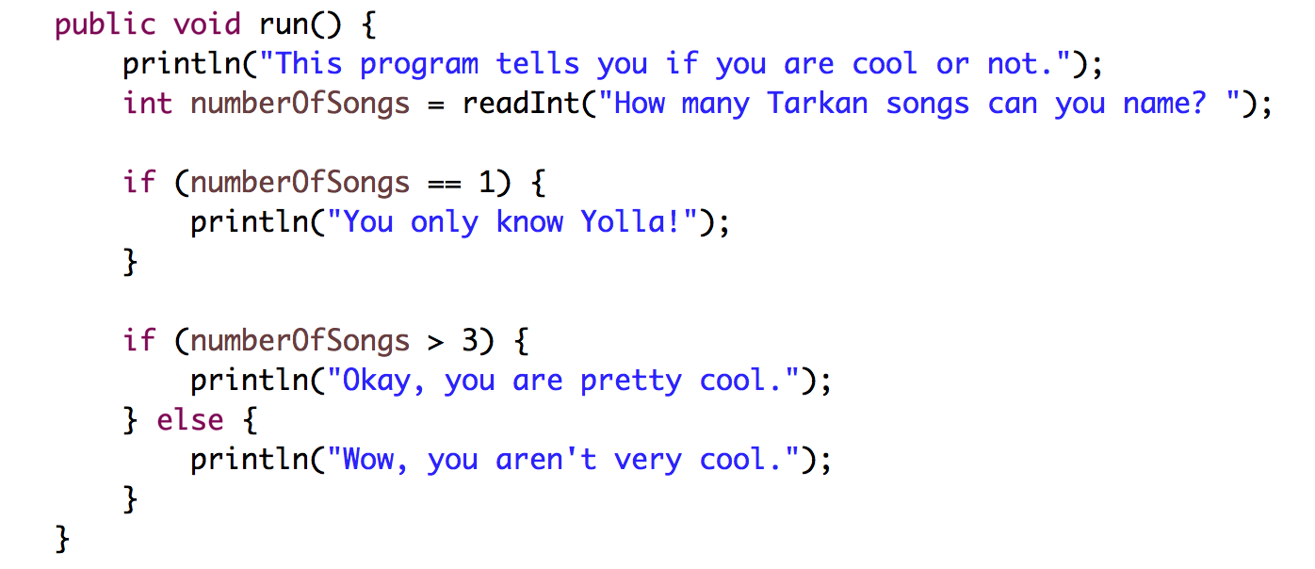
Conditions

Slide 55
Today’s Goals
✓
How do I write a console program?
What are variables and how do I use them?
How do I get user input in a console program?
✓
✓

Slide 56

Sandcastles

Slide 57
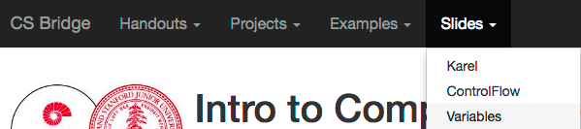
Website

